Slide 1
Repetition Structure

Slide 2
Repetition Structure
Repetition Structure or Loops: Allows repeat a section of your program a number of times
you to
certain
Repeats until the condition remains true
Terminates when the condition becomes false

Slide 3
Loops in C++
for loop
while loop
do loop
Counter-controlled loop
Conditional loop

Slide 4
Loops
Counter-controlled Loops
Depends on the value of a variable known as counter variable. The counter is changed (increased/decreased) in each iteration.
Example: for loop
Conditional loop
A conditional loop keeps repeating until a specific condition is met
Example: while and do loops

Slide 5
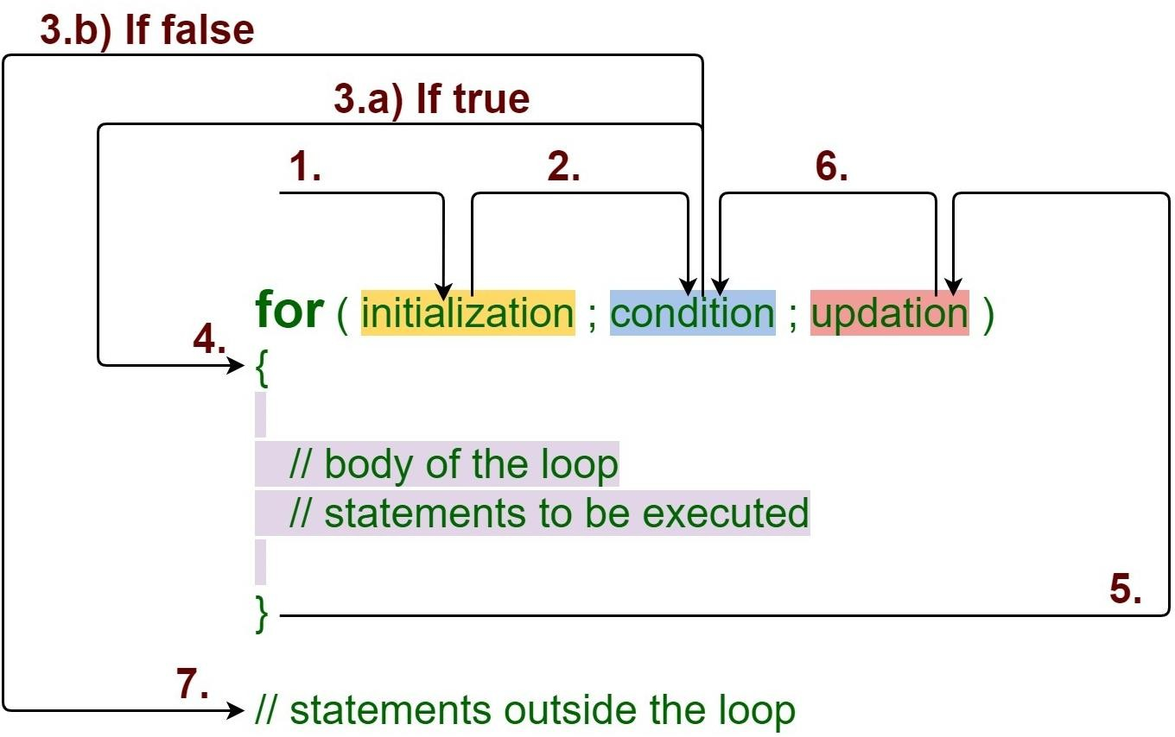
for Loop
https://media.geeksforgeeks.org/wp-content/uploads/20191108131134/For-Loop.jpg

Slide 6
for Loop - Example
Initialization
expression
Test Condition
Update expression
for (int j=0; j<10; j++)
cout << j * j <<endl;
6

Slide 7
(for loop) -- Class Exercise-1
- Get a number form user and calculate its factorial
7

Slide 8
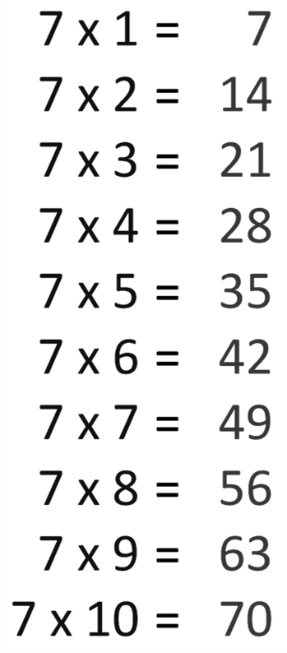
(for loop) -- Class Exercise-2
Write a program that ask the user to enter a number. The program should print the table of thet number (up to 10 values). Example…
Enter a number: 7

Slide 9
(for loop) -- Class Exercise-3
- Write a program that asks the user to enter two numbers (multiple of 10): speed1, and speed2 representing speeds in KPH (Kilo meters per Hour). Then the program should convert and show table of speeds in MPH (Miles per Hour) for all the speed values between speed1 and speed2.
MPH = KPH * 0.6214
speed1 and speed2 variables should be multiple of 10. Each table entry (in KPH) should be updated by 5 in each iteration.

Slide 10
for loop – Multiple Expressions
Multiple Increment/Dec expressions
Multiple Initialization
expressions
Test Condition
for (int j=0, k=9; j<10, k>5; j++,k--) cout << j * j <<endl;
cout<< k*k <<endl;

Slide 11
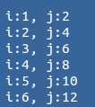
(1) for loop – Multiple Expressions
int i, j;
for(i=1,j=2; i<=3,j<=12; i++,j=j+2) cout<<"\n i:"<<i<<", j:"<<j;
Output?

Slide 12
(1) for loop - Variable Visibility
int main()
{
int j;
for(int j=0; j<10; j++) { k = j*j;
cout<<“\nValue of k: “<<k;
}
// j = 23; cannot do this! return 0;
}

Slide 13
(1) for loop – optional expressions
int j=0;
for(; j<10; j++)
cout<<“\nHello world“;
int j=0; for(; j<10;)
{
cout<<“\nHello world“; j++;
}
for(; ;)
cout<<“\nHello world“;
Infinite loop
(it never terminates)

Slide 14

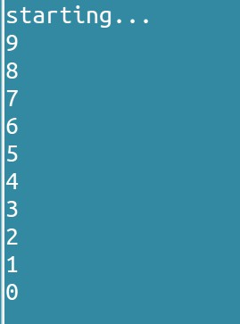
for loop
int i = 10; for(cout<<“Starting…”;i;cout<<i<<endl)
--i;
Output?

Slide 15
while loop

Slide 16
while loop
for loop does something a fixed number of times.
If you don’t know how many times you want to do something before you start the loop?
In this case a different kind of loop may be used: the while loop

Slide 17
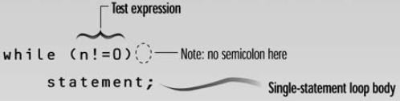
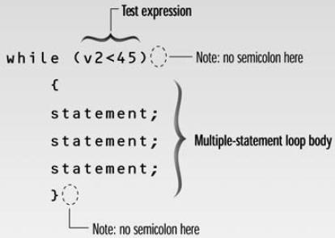
while loop - syntax
Loop body contain
single statement
Loop body contain Multiple statement

Slide 18
Example: Tracing a while Loop
Initialize count
int count = 0; while (count < 2)
{
cout << “\nWelcome to C++!"; count++;
}

Slide 19
Example: Tracing a while Loop
int count = 0; while (count < 2)
(count < 2) is true
{
cout << "Welcome to C++!"; count++;
}

Slide 20
Example: Tracing a while Loop
int count = 0; while (count < 2)
{
Print “Welcome to C++”
cout << "Welcome to C++!"; count++;
}

Slide 21
Example: Tracing a while Loop
int count = 0; while (count < 2)
{
cout << "Welcome to C++!";
Increase count by 1 count is 1 now
count++;
}

Slide 22
Example: Tracing a while Loop
(count < 2) is still true since count is 1
int count = 0;
while (count < 2)
{
cout << "Welcome to C++!"; count++;
}

Slide 23
Example: Tracing a while Loop
int count = 0;
while (count < 2)
{
Print “Welcome to C++”
cout << "Welcome to C++!";
count++;
}

Slide 24
Example: Tracing a while Loop
int count = 0; while (count < 2)
{
cout << "Welcome to C++!";
Increase count by 1 count is 2 now
count++;
}

Slide 25
Example: Tracing a while Loop
(count < 2) is false since count is 2 now
int count = 0;
while (count < 2)
{
cout << "Welcome to C++!"; count++;
}

Slide 26
Example: Tracing a while Loop
int count = 0; while (count < 2)
{
cout << "Welcome to C++!"; count++;
}
The loop exits. Execute the next statement after the loop.

Slide 27
(while loop) – Example
- Write a program that inputs a value in an integer number from user. For this number the program returns the count for how many times can we divide this number by 2 to get down to 1”.
int count = 0; int num; cin>>num;
//count how many divisions we've done while (num > 1)
{
num = num / 2; count++;
}
cout<<“\nWe have to divide: “<<count<<“ times”;

Slide 28
(while loop) – Example
infinite while loops…
while(true)
{
cout<<"\n Infinite loop";
}
while(10)
{
cout<<"\n Infinite loop";
}
while(‘A’)
{
cout<<"\n Infinite loop";
}

Slide 29
(while loop) – Example
while (numEntries = 3) //always true
{
cout <<"working … "; numEntries++;
}
while (numEntries = 0) //always false
{
cout << “never executed… ";
}

Slide 30
do loop

Slide 31
do loop
In while loop if condition is false it is never
entered or executed
Sometime, requirements are that the loop should be executed at least once….
For that, we use do loop, that guarantees at least on execution of the loop body

Slide 32
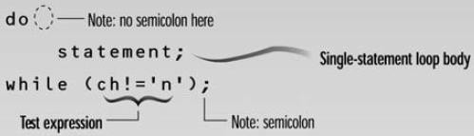
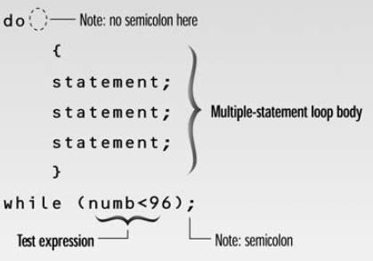
do while loop - Syntax
Loop body contain single statement
Loop body contain Multiple statement

Slide 33
do loop – Example1
int main( )
{
int counter, howmuch; cin>>howmuch;
counter = 0;
do {
counter++; cout<<counter<<endl;
} while ( counter < howmuch);
return 0;
}

Slide 34
do loop – Example2
int main( )
{
int num1, num2; char ch; do {
cout<<“\nEnter a number:”; cin>>num1;
cout<<“\nEnter another number:”; cin>>num2;
cout<<“\nTheir sum is: “<<num1+num2; cout<<“\nDo another time (y/n):”;
cin.get(ch);
} while(ch==‘y’);
return 0;
}

Slide 35
break Statement
break statement
Immediate exit from while, for, do/while, (also used in switch)
break immediately ends the loop that contains it.
Common uses:
Escape early from a loop
Skip remainder part of the loop and exit

Slide 36
break Statement - Examples
for (int i=1; i<=5; i++)
{
if (i==3)
break; cout<<“Hello”;
}
int n;
int EvenSum=0;
while(1)
{
cin>>n;
if(n%2==1)
break;
EvenSum = EvenSum + n;
}

Slide 37
(using break in loops) – Class Exercise 1
Write a program which reads an integer n from the user, and prints square value (n*n) for that number. Whenever ZERO is entered by the user program should terminate by printing “Invalid Value” message.

Slide 38
continue Statement
continue statement
Only ends the current iteration
Skips remainder of loop body (in current iteration)
Proceeds with next iteration of loop
“continue” can only be inside loops (for, while, or
do-while). IT CANNOT BE USED IN “switch”

Slide 39
continue Statement - Examples
for (int i=1; i<=5; i++)
{
if (i==3)
continue;
cout<<“Hello”<<i;
}
int n;
int EvenSum=0; while(1)
{
cin>>n; if(n%2==1)
continue;
EvenSum = EvenSum + n;
}

Slide 40
(Nested Loops)
Nested Repetition Structures

Slide 41
(Nested Loops)
In a nested repetition structure, one loop (inner loop) is placed entirely within another loop (outer loop)
In nested loops any loop (for, while, or do loop) can be placed inside another loop which can be a for, while, or a do loop

Slide 42
(Nested Loops) - Examples
Outer Loop
Inner Loop
for (int i=0; i<2; i++) {
for (int j=0; j<2;j++) {
cout<<“\nHello-”<<i<<“:“<<j;
}
}

Slide 43
(Nested Loops) - Examples
int main()
{
int weeks=3, days_in_week=7;
for (int i = 1; i <= weeks; ++i) { cout << "Week: " << i << endl;
for (int j = 1; j <= days_in_week; ++j) { cout << " Day:" << j << endl;
}
}
return 0;
}

Slide 44
(Nested Loops) – Exercise-1
- Write a program to print triangle of starts.
*
**
***
****
*****
******
*******
********
*********

Slide 45
(Nested Loops) – Exercise-2
- Write a program to print triangle of starts.
*********
********
*******
******
*****
****
***
**
*

Slide 46
(Nested Loops) – Exercise-3
- Write a
program to print Rectangle based on two
triangles (One using + and other using * symbol).
+********
++*******
+++******
++++*****
+++++****
++++++***
+++++++**
++++++++*
+++++++++

Slide 47
(Nested Loops) – Exercise-4
- Write a program for a company to calculate total sales for 3 regions. Each region’s sales is entered by user which is then summed in total regional sales. The program keep accepting regional sales until it is not 0. The program prints the final regional sum for three regions and exits.
Example Output:
Total Sales for Region 1: 87645
Total Sales for Region 2: 2312
Total Sales for Region 3: 8874

Slide 48
Arrays

Slide 49
Arrays
Collection data items
Collection of the same types of data.
Static entity – Same size throughout program

Slide 50








Arrays
Simple data type => a single value
15
84.35
‘A’
Structured data type => a collection of data values
Array is a structured data-type (collection of values)
85 | 79 | 92 | 57 | 68 | 80

Slide 51
One Dimensional Array
Collection of components
– All of the same type
Structure given a single name
Individual elements accessed by index indicating
relative position in collection
Index of an array must be an integer

Slide 52
One Dimensional Array
int WeeklyTemp[7];
WeeklyTemp
0
1
2
31
34
38
36
30
29
26
4 bytes
3
4
5
6
cout<<WeeklyTemp[0]; cout<<WeeklyTemp[2]; cout<<WeeklyTemp[4];

Slide 53
Declaring Array Variables
datatype arrayName[arraySize];
Example: double myList[10];
Array Size: must be constant (i.e., constant literal, constant identifier)
int size = 4;
double myList[size];
const int size = 4;
// Wrong
double myList[size]; // Correct double myList[20]; // Correct

Slide 54
Input/Output of Array elements
int marks[3];
marks[0] | = | 76;
marks[1] | = | 65;
marks[2] | = | 27;
cout<<marks[2]<<marks[0]<<marks[1];

Slide 55
Input/Output of Array elements – Using Loops
int marks[5]; for(int i=0;i<5;i++)
cin>>marks[i];
for(int j=0;j<5;j++) cout<<marks[j];

Slide 56
Indexed Variables
Array elements are accessed through the index.
Array indices are 0-based; that is, they start from 0 to arraySize-1, example:
int marks[5];
→ Five int values:
marks[0] marks[1] marks[2] marks[3] marks[4]
→ Using array values:
marks[2] = marks[1] + marks[0];

Slide 57
No Bound Checking
C++ does not check array’s boundary.
Subscripts (index variable) beyond the boundary
does not does not cause syntax errors,
Operating system may report a memory access violation (Compiler or System may crash!)
Example: …

Slide 58
Arbitrary Initial Values
When an array is created, its elements are assigned
with arbitrary values.
int marks[5]; for(int i=0;i<5;i++)
cout<<marks[i];

Slide 59
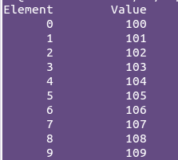
1D Array Example
int n[10]; //n is an array of 10 integers
// initialize elements of array n to 0 for (int i = 0; i<10; i++) {
n[i] = i + 100;
}
cout<<"Element"<<setw(13)<<"Value"<<endl;
// output each array element's value for (int j = 0; j<10; j++) {
cout<<setw(7)<<j<<setw(13)<<n[j]<<endl;
}

Slide 60
Initializing an Array
Declaring, creating, initializing in one step:
dataType arrayName[Size] = {value₀, value₁, ..., value_{k}};
Example:
int myList[4] = {32, 11, -6, 65};
What about: int List2[4];
List2= {32, 11, -6, 65};

Slide 61
Implicit Size
C++ allows you to omit the array size, example:
int myList[ ]={63,9,3,13};
C++ automatically figures out how many elements are in the array.
int myList [ ]; //WRONG

Slide 62
Partial Initialization
Initializing a part of the array:
double myList[4] = {1.9, 4.65}; //correct
The above example assigns values 1.9, 4.65 to the first two elements of the array.
- The other two elements will be set to zero.

Slide 63
Initializing arrays with random values
Following loop initializes the array myList with random values between 0 and 99:
int myList[10];
for (int i = 0; i < 10; i++) { myList[i] = rand( ) % 100;
cout<<“\nArray Element”<<i<<“ has val:”<<myList[i];
}

Slide 64
Copying Arrays
Can you copy array using a syntax like this?
int list[3];int myList[3]; list = myList; //Wrong
Copy individual elements from one array to the other as follows:
for (int i = 0; i < 3; i++) { list[i] = myList[i];
}

Slide 65
C-Strings or Character Arrays
The elements of an array can be just about
anything (any-datatype)
Consider an array whose elements are all characters (char type)
Called a C-String
Treated differently for I/O than other types of arrays

Slide 66
Declaration of C-Strings
Similar to declaration of any array:
char name[30]; // no initialization
char title[20] = //initialized at |  |  | “Hello World"; declaration with |  |  | a | string
char | chList[6] | = | {‘H', | ‘e', | ‘l', | ‘l‘, |  | ’o’};
//initialized with list of char values

Slide 67
Initializing Character Arrays
char city[ ] = “LAHORE";
'L' | 'A' | 'H' | 'O' | 'R' | 'E' | '\0'
city[0]
city[1]
city[2]
city[3] city[4]
city[5]
city[6]

Slide 68
Printing Character Array
For a character array, it can be printed using one print statement.
Character arrays are handled differently than other types of arrays
For example:
char city[ ] = “Lahore";
cout << city; //Correct
int marks [ ] = {20,65,30};
cout << marks; //Wrong

Slide 69
Character Array (string) Input
Declare strings 1 element bigger than planned size to allow for ‘\0’ (null character)
char city[10];
cin>>city; //User enters Islamabad (9 chars)
When input takes place, C++ automatically places the ‘\0’
in memory at the end of the characters typed in

Slide 70
Example-1: Summing All Elements
- Write a program to create an array of 100 elements, assign each element with the same value (its index uses). Sum all the array values and print the Sum.

Slide 71
Example-2: Reversing an Array
Write a program to create an array of 10 elements, assign each element a random value (1 to 50). Print the array values. Then, Reverse the values stored in array. Output the final array values.

Slide 72
Example-3: Searching in Array
- Write a program that creates an integer array having 50 elements. Then, ask the user to input values in the array. After that, find the largest number, smallest number in the and calculate the average of the values in the array.

Slide 73
Example-4: Searching in Array
-Write a program that creates an integer array having 100 elements. Then, randomly assign values (0—99) to the arrays elements. After that the program should ask the user to enter a number and print the total number of occurrences (how many time the number appeared) in the array.
-Example:
Enter the number: 29
The number 29 appeared 7 times in the array

Slide 74
Example-5: Finding Element
(Searching)
Write a program to create an array of 50 elements, initialize each element random value (1 to 100). Find the location (index) of the value entered by user. In the end, print both the index and largest value.
Example output:
Enter a number to search: 44 44 is at location 6

Slide 75
Sorting

Slide 76
Sorting An Array
Sorting: Arranging values of an array in Ascending or Descending order.
E.g., 65, 34, 12, 7, 5, 2, 1 {Descending order}
3, 13, 23, 37, 49, 87 {Ascending order}
Bubble Sort
Repeatedly stepping through the array to be sorted, comparing each pair of adjacent items and swapping
them if they are in the wrong order. The pass through the array is repeated until no swaps are needed (which indicates that the list is sorted)

Slide 77
Sorting An Array(Ascending) (bubble sort)

Slide 78
Sorting An Array(Ascending)
int a[10]={33,10,1,87,6,44,23,3,11,82};
int i,j,temp; int N=10;
for (i=0; i<N; i++)
{
for (int j=0; j<N-1-i; j++)
if (a[j] > a[j+1])
{
temp = a[j]; a[j] = a[j+1]; a[j+1] = temp;
}
}

Slide 79
Sorting An Array(Descending)
int a[10]={33,10,1,87,6,44,23,3,11,82};
int i,j,temp; int N=10;
for (i=0; i<N; i++)
{
for (int j=0; j<N-1-i; j++) if (a[j] < a[j+1])
{
temp = a[j]; a[j] = a[j+1]; a[j+1] = temp;
}
}

Slide 80
Two Dimensional Arrays

Slide 81
Two Dimensional Arrays
A two dimensional array stores data as a logical collection
of rows and columns
Each element of a two-dimensional array has a row position and a column position (indicated by two indexes)
To access an element in a two-dimensional array, you must specify the name of the array followed by:
a row index
a column index

Slide 82
Declaration and Initialization
Declaration of a two-dimensional array requires a
row size and a column size
A consecutive block of (row size)*(column size) memory locations are allocated.
All array elements must be of the same type.
Elements accessed by two offsets: a row offset
and a column offset.

Slide 83
2D Array - Example
//Declaration int data[2][3];
col 0
col 1
col 2
row 0
row 1
? | ? | ?
? | ? | ?

Slide 84
Declaring 2D Arrays
datatype arrayName[rowSize][coulmnSize];
Example:
double myList[2][4];
rowSize, and coulmnSize: MUST BE constant
constant literal
constant identifier

Slide 85
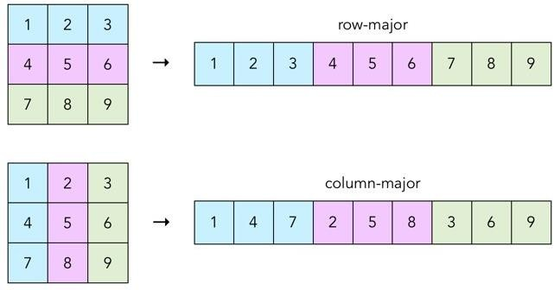
2D Arrays in Memory
Two Possibilities:
Row-major order
Column-major order
C/C++ follows row-major order
https://craftofcoding.files.wordpress.com/2017/02/rowcolumnarrays.jpg

Slide 86
Declaring and Initializing Arrays
int myList[3][2]={{22,33}, {44,55}, {66,77}};
→ myList has 3 Rows and 2 coulmns in each row:
Coulmn Indexes
0
1
0
22 | 33
44 | 55
66 | 77
Row Indexes
1
2

Slide 87
Initialization Examples
int | temp[4][3] | = | {{50, | 70, | 60}, | {48, | 75, | 62},
 |  |  | {51, | 69, | 60}, | {52, | 78, | 63}};
int t2[7][4]
= {{50, 70, 60}, {48, 75, 62},
{51, 69, 60}, {52, 78, 63}};
int | temp[][3] | = | {{50, | 70, | 60}, | {48, | 75, | 62},
 |  |  | {51, | 69, | 60}, | {52, | 78, | 63}};

Slide 88
Example: Input Using cin
Nested for loops are often used when inputting
and assigning values to a two-dimensional array
//Declaration
double table[10][10];
for (int i=0; i<10; i++) //every row for (int j=0; j<10; j++) //every col
cin >> table[i][j];

Slide 89
Example: Assignment
//Declaration const int RSIZE=3; Const int CSIZE=2;
double v[RSIZE][CSIZE];
for (int i=0; i<RSIZE; i++) //every row for (int j=0; j<CSIZE; j++ )//every col
v[i][j] = i+j;
V
0 | 1
1 | 2
2 | 3

Slide 90
Example: Computations
Compute the average value of an matrix with n
rows and m columns.
double sum=0; double average;
for (int i=0; i<n; i++) //every row for (int j=0; j<m; j++ )//every col
sum += array[i][j];
average = sum / (n*m);

Slide 91
2D Array Example-1
Compute the average value of the of a 2D array with r rows and c columns.
₃rd
row
double sum=0; double rowAverage;
for (int j=0; j<c; j++) //every col
sum += array[2][j];
average = sum / c;

Slide 92
Outputting 2D Arrays
Two dimensional arrays are often printed in a row by row format, using nested for statements.
for (int i=0; i<n; i++)
{
//every row
for (int j=0; j<m; j++ )//every col cout << array[i][j] << ‘ ‘;
cout << endl; //add end-of-line each row
}

Slide 93



Higher-Dimensional Arrays
- An array can be declared with multiple dimensions.
2 Dimensional 3 Dimensional
double Coord[100][100][100];
- Multiple dimensions get difficult to visualize graphically.
•
Single value
1D Array
2D Array
3D Array

Slide 94
Larger-Dimension Arrays
Arrays with more than two dimensions allowed
in C++ but not commonly used
Example:
int ThreeD[4][10][6];
» First element: ThreeD[0][0][0]
» Last element:ThreeD[3][9][5]

Slide 95
(Nested Loops) – Example Program-1
- Write a program to that creates a matrix of size 5 by 5 (5 Columns, and 5 Rows). The program should ask the user to enter values in each matrix element. Then the program should display the matrix Row-wise.
Example:
1 | 2 | 3 | 4
5 | 6 | 7 | 8
9 | 10 | 11 | 12
13 | 14 | 15 | 16
1, | 2, | 3, | 4,
5, | 6, | 7, | 8,
9, | 10, | 11, | 12,
13, | 14, | 15, | 16,
Output

Slide 96
(Nested Loops) – Example Program-2
- Write a program to that creates a matrix of size 5 by 5 (5 Columns, and 5 Rows). The program should ask the user to enter values in each matrix element. Then the program should display the matrix Coulmn-wise.
Example:
1 | 2 | 3 | 4
5 | 6 | 7 | 8
9 | 10 | 11 | 12
13 | 14 | 15 | 16
1, | 5, | 9, | 13,
2, | 6, | 10, | 14,
3, | 7, | 11, | 15,
4, | 8, | 12, | 16,
Output

Slide 97
(Nested Loops) – Example Program-3
- Write a program to that creates a matrix of size 10 by 10 (10 Columns, and 10 Rows). The program should ask the user to enter values in each matrix element. Then the program should display the left-diagonal elements of the matrix.
Example (5 by 5 matrix):
1 | 2 | 3 | 4
5 | 6 | 7 | 8
9 | 10 | 11 | 12
13 | 14 | 15 | 16
Output
1, | 6, | 11, | 16,

Slide 98
Example-4: Zero Matrix
Write a program that creates a matrix of 3 by 3 (3 rows, and 3 coulmns). Get input values from the user for the complete matrix. Then, the program should determine whether the matrix is a “Zero” matrix (all elements are zero) or not.

Slide 99
Example-5: Coulmn sum
Write a program that creates a matrix of 4x4 (4 rows, and 4 coulmns). Get input values from the user for the complete matrix. The program should calculate and print the sums of each individual coulmn.

Slide 100
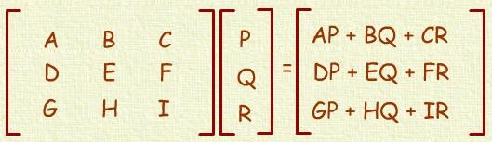
Example-6: Matrix Vector
Write a program that creates a matrix of 7 by 7 (7 rows and 7 coulmns). Create a 1D array having 6 elements. The program should multiply the matrix with the given vector and print the resultant matrix in proper format.

Slide 101
Example-6: Matrix Vector-code
int A[4][4];
int B[4]; int C[4]; int r;
// Get input in the “A” matrix and “B” array for(int i=0; i<4; i++)
{
r = 0;
for(int j=0;j<4; j++)
r = r + A[i][j] * B[j];
C[i] = r;
}

Slide 102
Any Questions!

